Slide 1
“Organizational Patterns”
Department of Computer Science

Slide 2
Organization: Logical Relation in the Text
If you are clear, concise, and accurate, but no one can follow your train of thoughts because your text rambles, you still have not communicated effectively.
The link between clear, logical organization and effective communication is powerful, both for the "sender" and the "receiver."
It provides focus and direction as the writer composes the document, which helps to ensure that the stated purpose is fulfilled.
For the reader, clear organization greatly enhances the ease with which one can understand and remember the information being presented.
People seek out patterns to help make sense of information.

Slide 3
Patterns of Organization
Spatial Order
Chronological Order
Order of Importance
Comparison/ Contrast
Problem/Solution

Slide 4
1. Spatial Order
Text organized spatially if you are writing to describe the parts of a machine or a plot of ground.
Describe what you see in order of space: left to right, top to bottom, inside to outside, or clockwise.
Spatial sequence helps reader visualize what you see and, therefore, better understand the physical qualities of the subject matter.

Slide 5
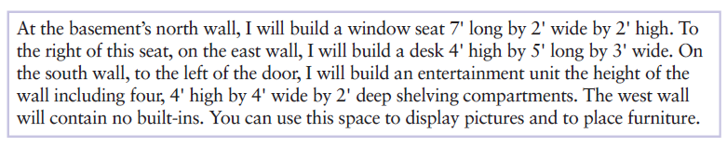
Example of Spatial text

Slide 6
Chronological Order
Chronological refers to time period
Reference to specific times or dates
Includes transition words such as first, then, and last to indicate the passage of time
Each main section of information represents a particular period of time, and the sub-points contained within each main section refer to significant events that occurred within that time frame.

Slide 7
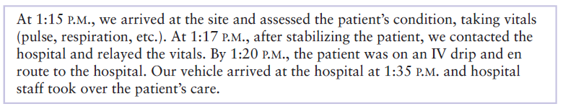
Example of Text Showing Chronological Order

Slide 8
3. Order of Importance
Your page of text is like real estate. Certain areas of the page are more important that others.
Arranged according to their order of importance
Writers may begin with most important supporting points and end with the least important.
Some may begin with least important and end with the most important, allowing them to build a high point, or climax

Slide 9
Example of Text According to Order of Importance
Several considerations should influence your choice of a career. First, you should choose a career that will provide the lifestyle you want. If living in an expensive house and driving a big car are your goals, you should decide to be a schoolteacher or an engineer. Although it is possible to make a good living in these professions, most teachers and engineers make rather modest salaries, especially at the beginning of their careers. Second, and more important, you should choose a career for which you have an aptitude. Even though you may love art, if you have no talent as an artist, you will not be successful. Finally, and most important, you should choose a career you will enjoy.

Slide 10
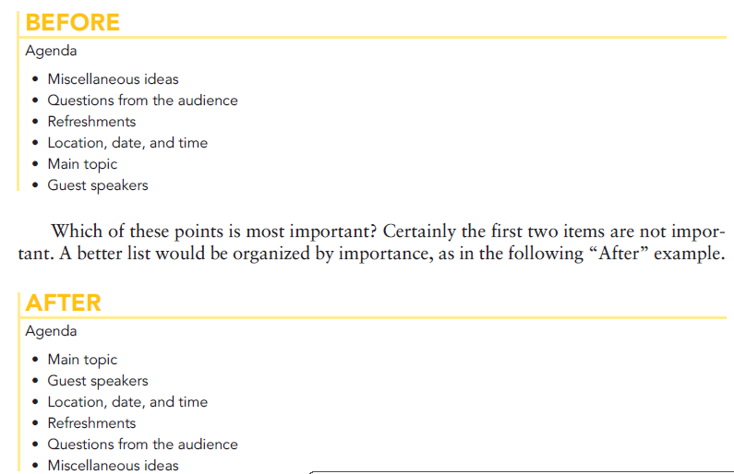

Slide 11
4. Comparison/contrast
Compare similarities and contrast differences
For example, if you are writing a sales brochure, you might want to present your potential client alternatives regarding services, personnel, timetables, and fee structures.

Slide 12
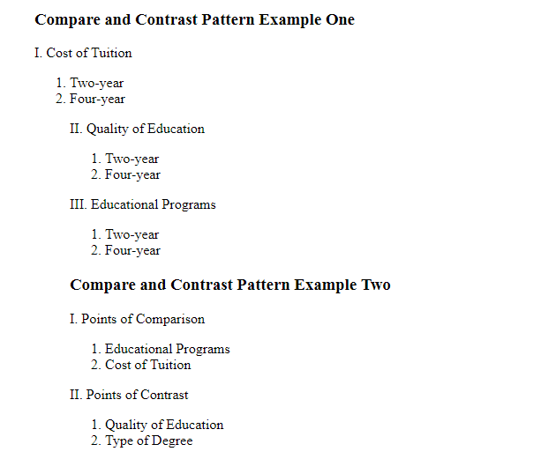

Slide 13
Problem/Solution
Every proposal and sales letter is problem/solution oriented
Proposing a solution to an existing problem

Slide 14
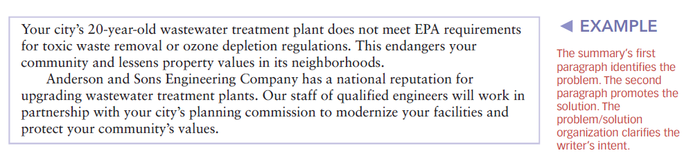

Slide 15


